Slide 1


Lecture 2 Functional Programming in Scala
21.3.2023
Iflaah Salman

Slide 2
Scala as Functional Language
Functions are like instances or values and can be:
Assigned to variables [val, var]: can hold a reference to a function that makes them part of the type system in Scala.
Passed as parameters to functions.
Returned as results of functions.
Written as function literals.
they can be evaluated which results in the function being executed.
Notes:
A function literal is an alternate syntax for defining a function (anonymous functions). It's useful when you want to pass a function as an argument to a method (especially a higher-order one like a fold or a filter operation) but you don't want to define a separate function.

Slide 3
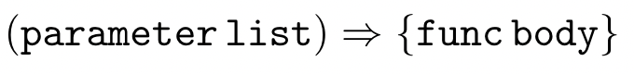
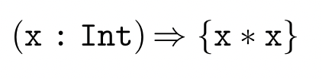
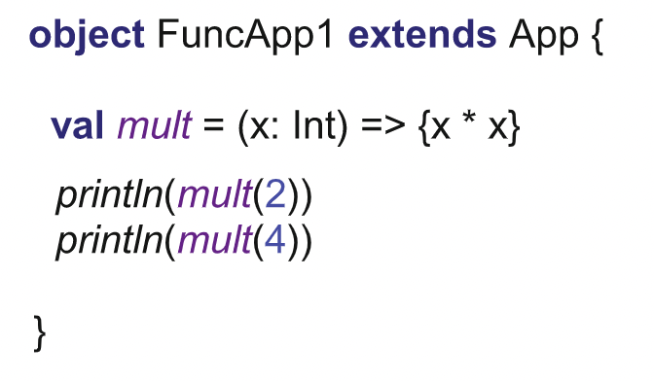
Defining Scala Functions
It takes a single parameter of type Int and returns an Int.
The signature is
(Int): Int
Assigning the function to a local variable or to a property.
Now we can invoke the function via that variable or property.
4
16
Notes:
Scala is smart enough to know the return type. But for good coding practices, one should explicitly mention it.

Slide 4
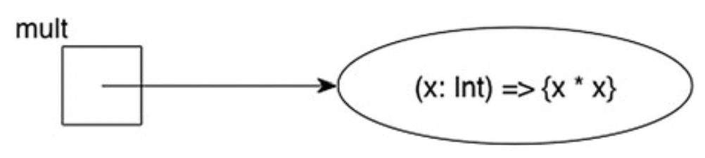
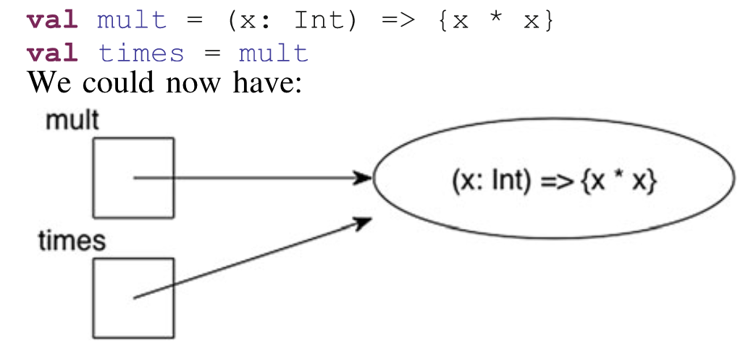


Defining Scala Functions
mult holds a reference to a function.
Function is an entity within the language rather than just some code written within an object (as is the case for methods).
Therefore, we can also assign the function referenced by mult to another variable.
The results of both statements are the same!
As an effect, mult and times are aliases for the same functionality.
Notes:
Scala is smart enough to know the return type. But for good coding practices, one should explicitly mention it.

Slide 5
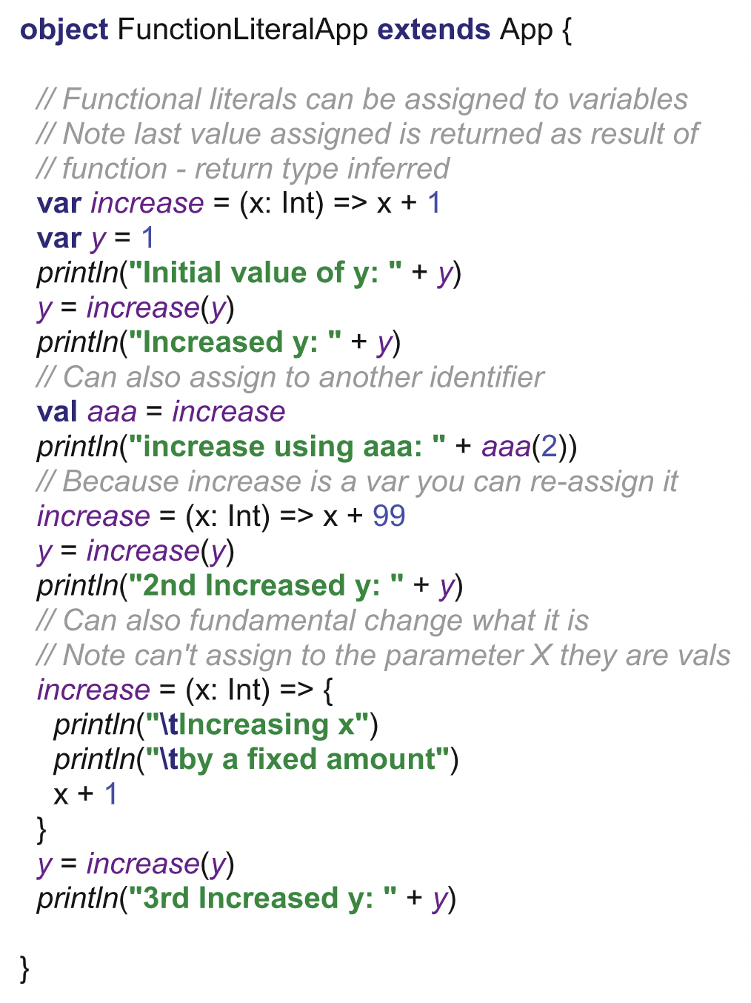
Defining Scala Functions!
increase is a var we can reassign to it.
Thus we can change the function referenced by increase.
Notes:
Scala is smart enough to know the return type. But for good coding practices, one should explicitly mention it.

Slide 6
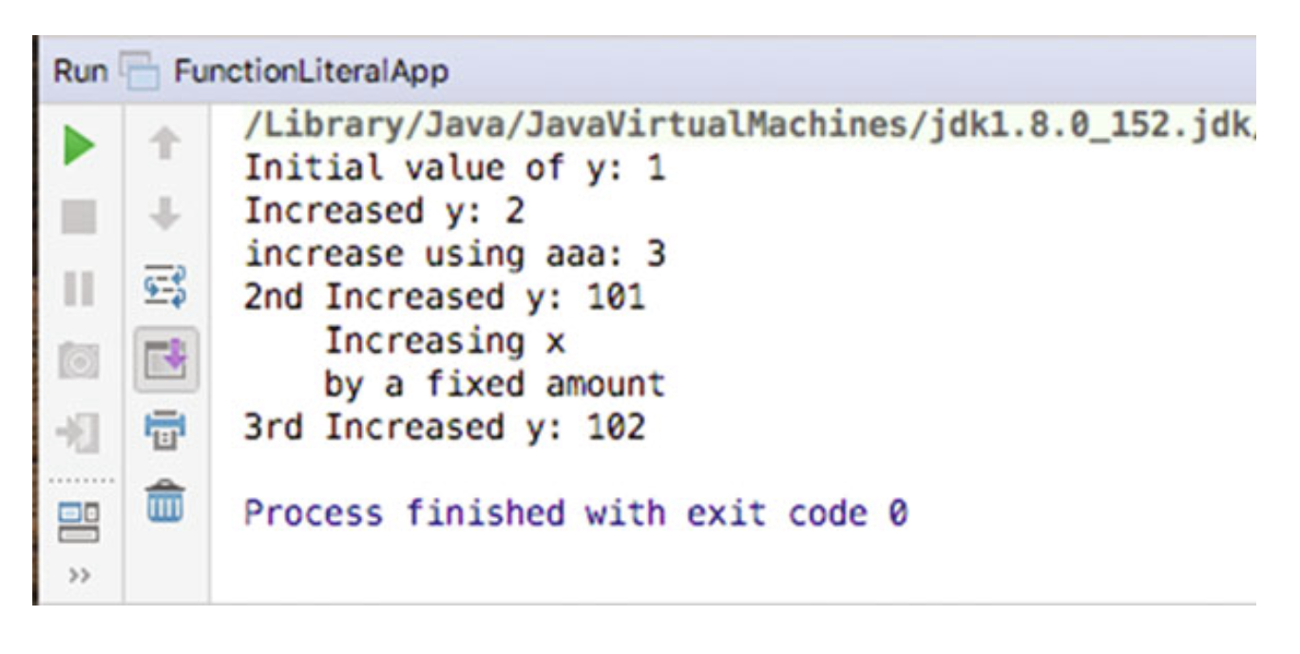
Defining Scala Functions
Notes:
Scala is smart enough to know the return type. But for good coding practices, one should explicitly mention it.

Slide 7
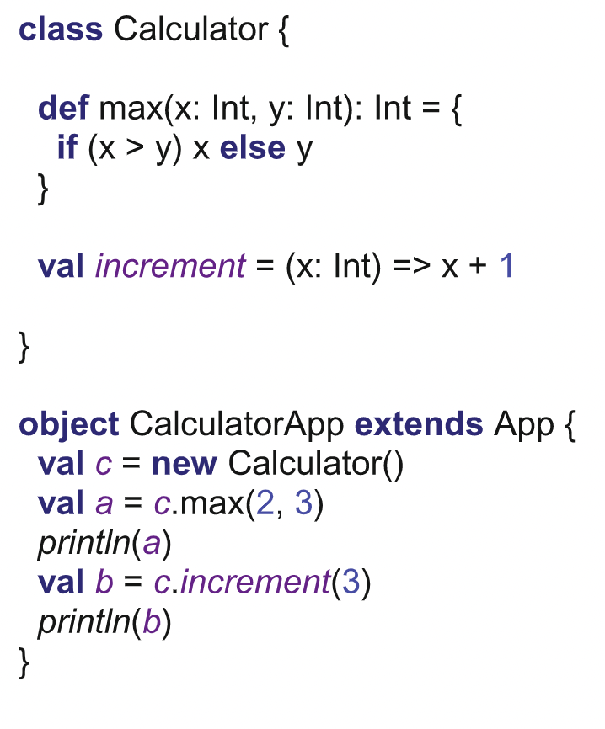
Class, Objects, Methods and Functions
Classes and objects can have both methods and functions defined for them as their members.
In many cases you can ignore the difference between methods and functions.
A method defines behaviour which is tied to the class or object
A function defines an operation held by the class or object

Slide 8
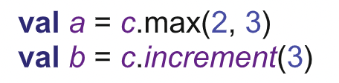
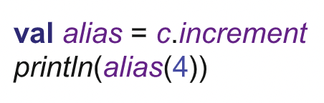
Class, Objects, Methods and Functions
Calculator that defines both a method max and a function increment.
The method max is an integral part of the definition of the class Calculator.
increment is a read-only val property which holds a reference to the function
Invoking via dot notation.
This assignment cannot be done for methods because they are not separate entities.

Slide 9
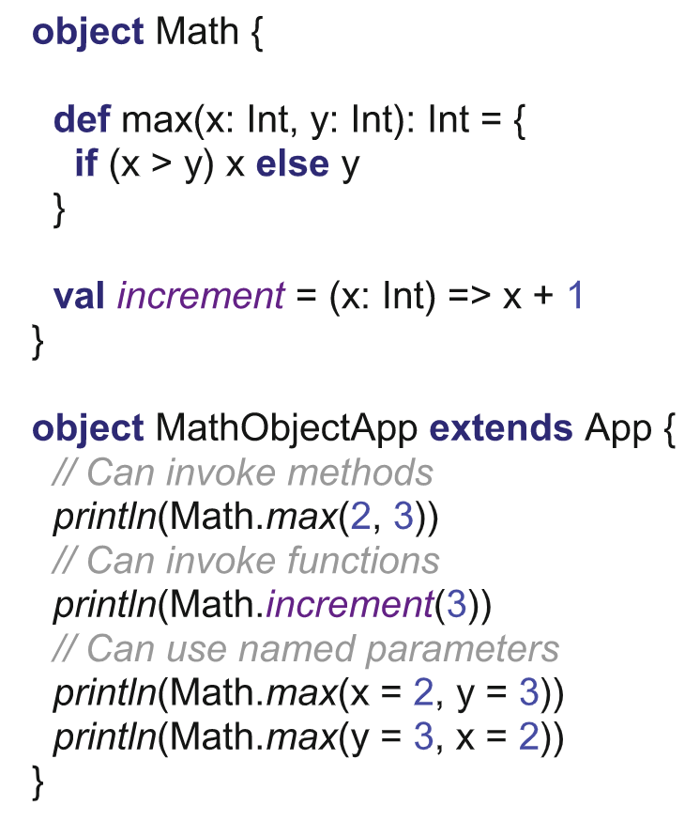
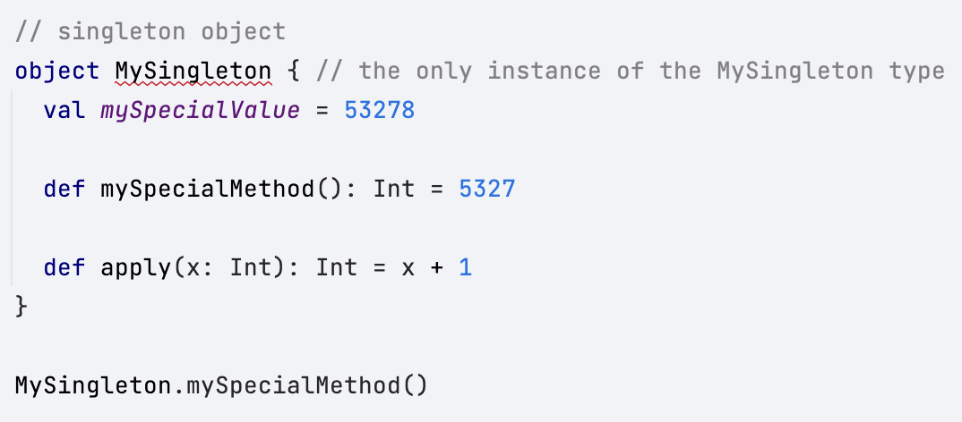
Class, Objects, Methods and Functions
Object
The object keyword creates a new singleton type, which is like a class that only has a single named instance.
https://www.youtube.com/watch?v=8V6bMjThNo&list=PLmtsMNDRU0BxryRX4wiwrTZ661xcp6VPM
Notes:
As you can see, we’ve not instantited it first to access its methods or functions like a Class.

Slide 10
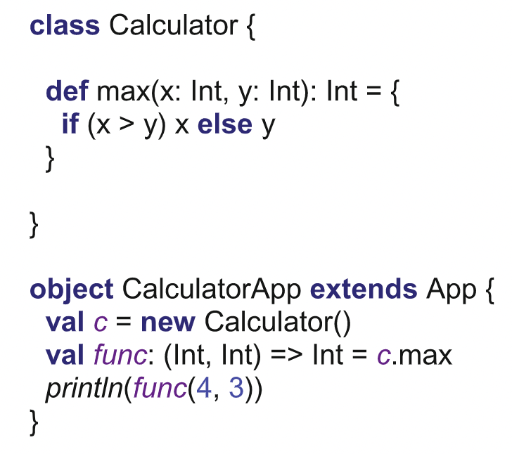

Lifting Methods
Lifting a method means treating a method as if it were a free-standing function.
max on an instance of the class Calculator is assigned to a variable
func of type (Int, Int) => Int
a function that takes two Integer parameters and returns an Integer.
The method max is wrapped up in a func function that would invoke the method.
func holds a reference to a lambda (function literal) that has been created for us by Scala and that references the method max

Slide 11
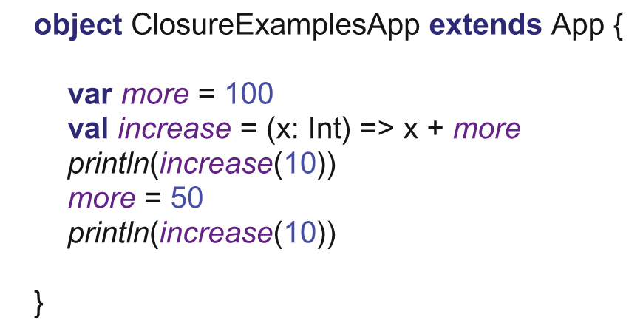
Closure
A closure (or a lexical closure or function closure) is a reference to a function together with a referencing environment.
This referencing environment records
the context within which the function was originally defined and
if necessary a reference to each of the non-local variables of that function. These non-local or free variables allow the function body to reference variables that are external to the function but which are utilised by that function.

Slide 12
Closure!
it is the current value of more that is being used.
variable more is still in scope within the same method as the invocations of the function referenced by increase.
Notes:
110
60

Slide 13
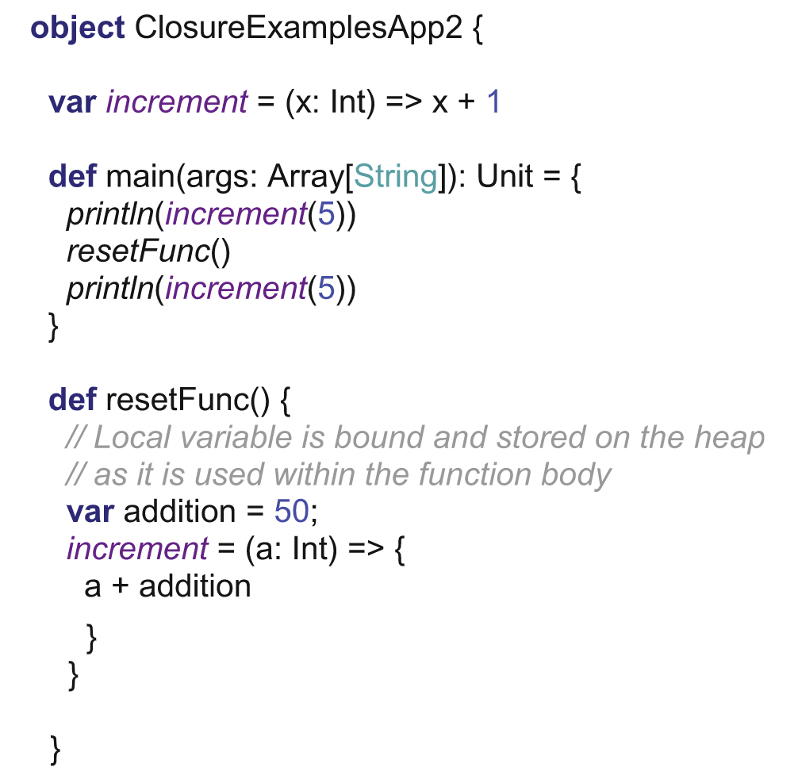
Closure!
resetFunc() method has a variable that is local to the method.
The variable addition is used within the method body of a new function definition.
This new function is then assigned to the property increment.
the second invocation of increment occurs, back in the main method after the resetFunc() method has terminated.
Normally the variable addition would no longer even be in existence, but we have “closure”.
increment when called the second time in the main method is the one defined within resetFunc() and which uses the variable addition.

Slide 14
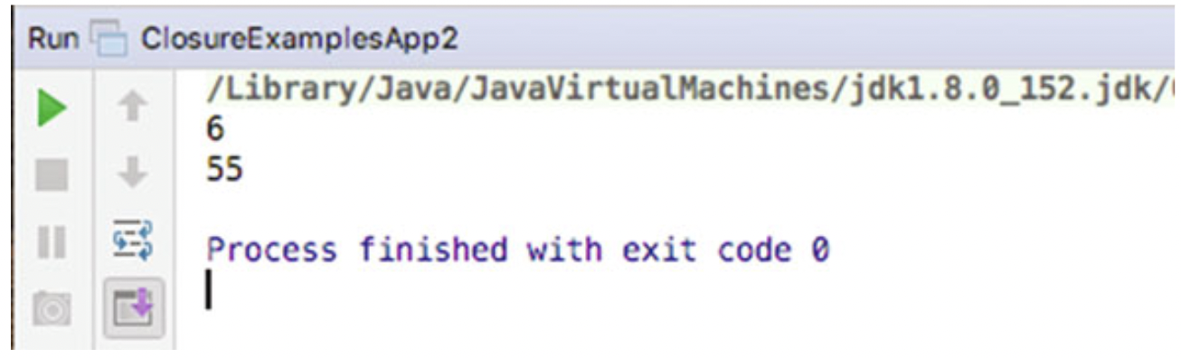
Closure!
Scala ensures that the variable addition is available to the function, even if the invocation of the function is somewhere different to where it was defined.
Scala does so by binding any free variables (those defined outside the scope of the function) and storing them so that they can be accessed for the function’s context (in effect moving the variable from the local stack to the heap).
Notes:
Heap: When an object is created, it is always created in Heap and has global access. That means all objects can be referenced from anywhere in the application.
Stack: This is the temporary memory where variable values are stored when their methods are invoked. After the method is finished, the memory containing those values is cleared to make room for new methods.

Slide 15
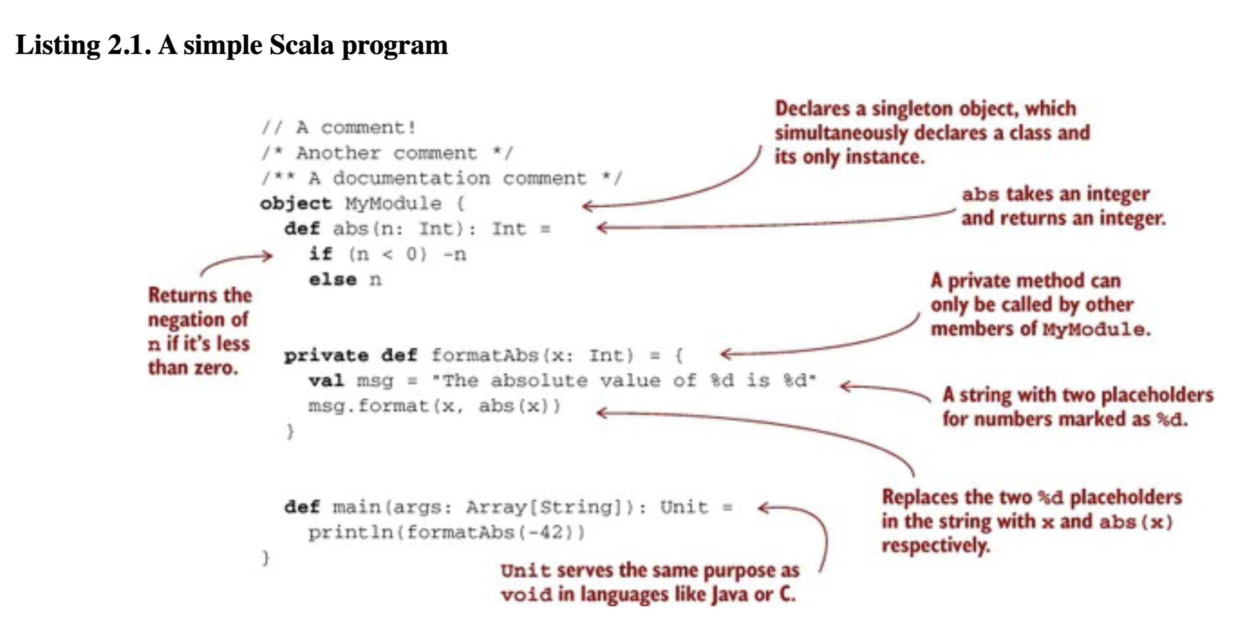
Notes:
Format() is a standard libaray method defined on String.
This method is declared private, which means that it cannot be called from any code outside of the MyModule object. This function takes an Int and returns a String, but note that the return type is not declared.
Output: The absolute value of -42 is 42.

Slide 16

References
Chiusano, P., & Bjarnason, R. (2014). Functional Programming in Scala. Manning publications.
Hunt, J. (2018). A Beginner’s Guide to Scala, Object Orientation and Functional Programming. In A Beginner’s Guide to Scala, Object Orientation and Functional Programming. Springer International Publishing. https://doi.org/10.1007/978-3-319-75771-1

